Slide 1
SDA in the repository
Repository Fringe 2016
2016-08-2
Laine Ruus, University of Edinburgh. EDINA and Data Library
laine.ruus@ed .ac.uk or laine.ruus@utoronto.ca

Slide 2
Outline
Weaknesses of current repository systems
What is SDA?
What SDA does for researchers
What SDA does for teachers
What SDA does for repositories
SDA and sensitive data
Why repositories need SDA or equivalent
Homework

Slide 3
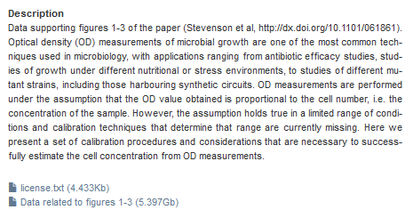
Weaknesses of current repository systems
Pass-through systems
User takes all or nothing in many cases
Metadata – one size fits all?
SDA won’t provide a solution to all these issues
for all data, but can resolve some problems
for some types of data

Slide 4
What is SDA?
SDA stands for Survey Documentation and Analysis
SDA does for encoded numeric data what Windows Media Player, PhotoShop, etc, do for sound and video files: the job of the software is rendering, our job is interpretation
Winner of the following awards:
American Association for Public Opinion Research (AAPOR): Warren J. Mitofsky Innovators Award
American Political Science Association (APSA): Best Instructional Software Award

Slide 5
Unless you are Russell Crowe, or John Forbes Nash…

Slide 6
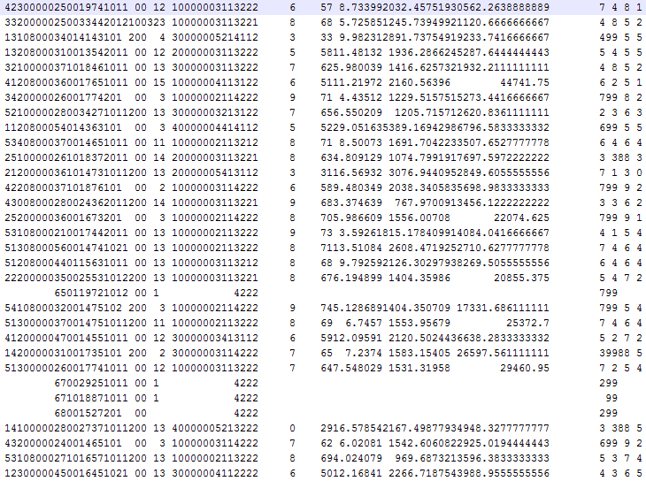
… you probably can’t make much sense
of this
We make sense of numeric
microdata by creating summary
descriptive statistics
- and by generating inferential
statistics to establish and
describe relationships among
characteristics
SDA can do all of the above…

Slide 7
SO What is SDA?
a server-side application, accessed through any forms-capable web browser (IE, Firefox, Chrome, etc)
a user-friendly interface, with lots of context-specific help screens.
provides statistical analysis capability for microdata, and to a certain extent, for aggregate and time-series data,
generates descriptive and inferential statistics, manipulates data, and generates basic visualisations of the content of numeric data
provides "slice-and-dice" access to numeric data
University of Edinburgh Data Library has installed an SDA server accessible from:
http://www.ed.ac.uk/information-services/research-support/data-library

Slide 8
What SDA does for researchers:
all metadata about a variable can be consolidated in one location
univariate descriptive statistics, with/without standard measures of shape, variance, skewness, etc
multivariate descriptive statistics, with/without standard measures of central tendency, dispersion, significance
inferential statistics: comparison of means, correlations and regressions (multivariate, logit or probit)
recode variables, and/or compute new variables, and share them with others (or not)
analyse with/without control and/or filter variables
compute 90%, 95%, or 99% confidence intervals (asymmetric)
turn weighting off/on (it is on by default, if weight variables are defined)
compute design effects (deft) for complex sample surveys with stratum/cluster variables
download either the whole dataset or a bespoke subset (including recoded/computed variables) for analysis in other software
basic data visualisations, such as histograms, pie charts, line charts

Slide 9
What SDA does for TEAchers:
an accessible source of data for exercises/assignments
teach numeracy (e.g. how to read tables) without having to teach software
teach introductory and intermediate level statistics without having to teach software
teach the difference between simple random sample (SRS) and complex sample designs and how they affect measures (design effects (deft)).
saved output files contain information about variables, recodes and computes, control, filter, stratum and/or cluster, and weight variables to document what the student did
variable recodes and new, computed variables, can be shared with students or other researchers/teachers
a vehicle for distance education, without software licencing issues
a vehicle with which to share your own data with other researchers or with a class.

Slide 10
What SDA does for repositories:
access to numeric data as a source for descriptive/inferential statistics, without requiring users to have expensive/hard to learn statistical analysis software
access to data with all relevant variable-level metadata in one interface
stores a generic-format data file and DDI-compliant metadata file, as well as syntax files for ingesting the data into SAS, SPSS, and/or Stata (ie a long-term preservation format)
access to data without having to remove sensitive variables
can be configured to provide only pre-defined tables (cross-tabulations)
can be configured to allow users to load their own data files
provide access to enhanced version(s) of data files, to facilitate analysis

Slide 11
SDA and sensitive data
for sensitive data, SDA is FISMA-moderate compliant:
individual variables or variable combinations can be embargoed,
cell count limits can be imposed,
downloading data and listing cases can be disabled, etc.
analysis with control and/or filter variables can be disabled
for additional capabilities, see http://sda.berkeley.edu/man40h/disclosure.htm
account and password protection at the file level
IP-address range protection at the file level
for even more sensitive data, SDA Quick Tables facility allows making available only pre-defined tables
Ie, SDA provides privacy protection at the point of analysis, not at the point of ingest
the repository can store the full dataset, and provide access to a ‘sanitized’ version without maintaining separate versions

Slide 12
SDA and sensitive data – check it out
individual statistical procedures can be disabled
eg: http://stats.datalib.edina.ac.uk/sdaweb/analysis/?dataset=sda_test
use of control and filter variables can be disabled
eg: http://stats.datalib.edina.ac.uk/sdaweb/analysis/?dataset=sda_test
individual variables or variable combinations can be embargoed
eg: Scottish school leavers survey, 1981 – any variables labelled ‘not public’
downloading and listing cases can be disabled, etc.
eg: http://stats.datalib.edina.ac.uk/sdaweb/analysis/?dataset=sda_test
account and password protection
eg: Growing up in Scotland, cohort 1, sweep 6, 2010-2011 (subset)
Quick Tables:
eg: http://sda.berkeley.edu:8080/quicktables/quickconfig.do?datasetKey=gss04

Slide 13
Why repositories need SDA or equivalent
Be responsive to the needs of your users, ie those researchers/students who will eventually use the data in your repository
Encourage secondary usage of numeric data by providing
enhanced, DDI-compliant metadata in one location
‘slice-and-dice’ functionality
analytic functionality
Minimise the work involved in privacy-proofing human/corporate-based data, and checking it, on the part of the researcher, as well as yourself
The full utility of a dataset should not be compromised – in time, those legal privacy protections for human-based data will expire. Store the whole dataset, just proscribe the analyses – your grandchildren and great-grandchildren will thank you!

Slide 14
SDA isn’t for every dataset
Since 2008, the Univ. of Edinburgh DataShare repository has ingested the following types of files:
collection (1)
dataset (237) – most of these are not numeric data in this sense
Image (1)
image (974)
interactive resource (3)
moving image (26)
software (11)
sound (153)
text (8)
Nor do you necessarily need your own SDA server – you can piggy-back on someone else’s.

Slide 15
Homework: make like a researcher - 1
U Edinburgh’s SDA server: http://stats.datalib.edina.ac.uk/sda/
Univariate descriptive statistics
Q: did the UK population in 2011 in perceive itself to be in good/bad health?
Dataset: Census microdata teaching file, 2011
Row variable: health
Output options: summary statistics
Chart options: line chart or bar chart

Slide 16
Homework: make like a researcher - 2
Cross-tabulation (bivariate descriptive statistics)
Q: which UK country in 2011 had most in excellent health?
Dataset: Census microdata teaching file, 2011
Row variable: health; Column variable: country
Output options: summary statistics
Cross-tabulation (bivariate descriptive statistics)
Q: which UK country in 2011 had most people in very bad health?
Dataset: Census microdata teaching file, 2011
Row variable: health; Column variable: country
Output options: cell contents: Percentaging - Row
Output options: summary statistics

Slide 17
Homework: make like a researcher - 3
Cross-tabulation (bivariate descriptive statistics) - 3
Q: might there be an association between socio-economic status and perceived health?
Dataset: Census microdata teaching file, 2011
Row variable: health; Column variable: socgrd, Control variable: country
Output options: cell contents: Percentaging - Column
Output options: summary statistics
Chart options: type of chart: bar chart
Q2: what other characteristics that are available in this dataset might have an association with perceived health?

Slide 18
Homework: make like a researcher - 4
Comparison of means
Q: might there be an association between cultural/material possessions in the home, and enjoying maths? In what direction? How is Scotland different?
Dataset: PISA 2012: student questionnaire data set
Dependent variable: cultpos; Row variable: st29q04; Column variable: nc; Selection filter: nc(82610,82620,12400,75200)
Output options: SRS std errs, Z/T-statistic, P-value, ANOVA stats
Chart option: bar chart or line chart

Slide 19
Homework: make like a researcher - 5
Regression
Q: do gender and father’s socio-economic class, have an effect on success in school, measured as the number of O-level A-C grade achieved?
Dataset: Scottish school leavers (1980) survey, 1981
Dependent variable: totoac; Independent variables: sex(d:1), dadclass(m:50)
Sample design: SRS

Slide 20
What questions do you have?

