Slide 1
Handling data using SPSS
Course instructors: Stuart Macdonald and Laine Ruus (stuart.macdonald@ed.ac.uk and laine.ruus@ed.ac.uk)
University of Edinburgh. Data Library
2016-11-14

Slide 2
Outline:
The data log file
Configuring SPSS
Reading raw data into SPSS
Adding metadata
Checking the data: basic descriptive statistics
Common recode and compute operations
Merging files: adding variables and/or cases
Writing data out from SPSS

Slide 3
[Michael] Cavaretta said: “We really need better tools so we can spend less time on data wrangling and get to the sexy stuff.” Data wrangling is cleaning data, connecting tools and getting data into a usable format; the sexy stuff is predictive analysis and modeling. Considering that the first is sometimes referred to as "janitor work," you can guess which one is a bit more enjoyable.
In CrowdFlower's recent survey, we found that data scientists spent a solid 80% of their time wrangling data. Given how expensive of a [sic] resource data scientists are, it’s surprising there are not more companies in this space.
Source: Biewald, Lukas Opinion: The data science ecosystem part 2: Data wrangling. Computerworld Apr 1, 2015
http://www.computerworld.com/article/2902920/the-data-science-ecosystem-part-2-data-wrangling.html

Slide 4
Questions you need to be able to answer, re any software you decide to use:
does the software support the statistical analyses most appropriate for my research question and data?
how good are the measures that it will produce, for example chi-square, pseudo-R²?
will it support the data exploration and data transformations I need to perform, or do I need to do them in some other software?
how will I get my data into the software (ie what data file formats can it read)?
how can I get my data out of that software (along with any transformations, computations etc) so that I can read it into other software for other analyses, or store it in a non-software dependent format for the longer term? Ie what data file formats can it write?

Slide 5
Advantages of SPSS
flexible input capabilities, (eg hierarchical data formats)
flexible output capabilities
metadata management capabilities, such as variable and value labels, missing values etc
data recoding and computing capabilities
intuitive command names, for the most part
statistical measures comparable to those from SAS. Stata, etc.
good documentation and user support groups (see handout, Appendix A)
Disadvantages of SPSS
doesn’t do all possible statistical procedures (but then, no statistical package does)
does not handle long question text well
allows very long variable names (>32 characters) which can’t be read by other statistical packages
default storage formats for data and output log files are software-dependant (but this is also true for most statistical packages)

Slide 6
The data we will be using:
Subset of variables and cases from:
Sandercock, Peter; Niewada, Maciej; Czlonkowska, Anna. (2014).
International Stroke Trial database
(version 2), [Dataset].
University of Edinburgh,
Department of Clinical Neurosciences.
http://dx.doi.org/10.7488/ds/104.

Slide 7
Files are located in: Libraries > Documents > SPSS Files
IST_logfile.xlsx – a sample log file in Excel format
ist_corrected_uk1.csv – a comma-delimited subset, which we will read into SPSS
ist_labels1.sps – an SPSS syntax file to add variable/value-level metadata to the SPSS file
ist_corrected_uk2.sav – an SPSS system file from which we will add variables
ist_corrected_eu15.sav – an SPSS system file from which we will add cases

Slide 8
First, create a data log file:
use Excel, Word, Notepad – your choice
fields to include:
current date (eg YYYYMMDD)
input file path and filename
format (especially important if you are working in a MacOS environment, which does not require format based filename extensions)
output file path and filename
output format
comment as to what was done between input and output.
first entry should be where you obtained the data [if doing secondary analysis]
rename sheet 1 [if using Excel], eg ‘data_log’
save the log file (assign a location and name that you will remember), but leave it open.

Slide 9
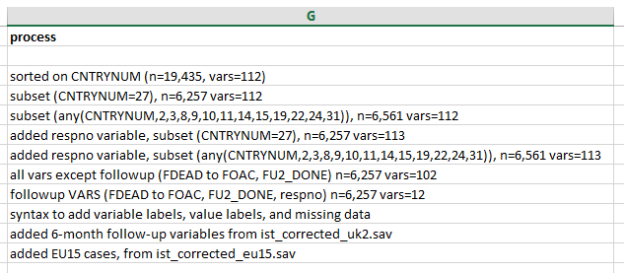
Sample data log file [in Excel]

Slide 10
Cautions re subdirectory and file names: - different operating systems treat embedded blanks in subdirectory and file names differently
Do not use blanks or most other special characters in subdirectory and/or file names
Do use
underscores, or
CamelCase
Х ‘variable list.xls’
√ variable_list.xls, or
√ VariableList.xls

Slide 11
You may not always use SPSS for analysis, nor the same version of SPSS
may need to migrate data from/to different computing environments (Windows, Mac, Linux/Unix) and/or different statistical software, because no statistical package supports all types of analysis (SAS, SPSS, Stata, R, etc).
see table at http://stanfordphd.com/Statistical_Software.html
Therefore, constraints on length of
file names
variable names
variable labels
value labels
missing values codes, number and type

Slide 12
Limits [at time of writing]
Note: it is generally recommended
that variable names be no more
than 8 characters

Slide 13
Running SPSS:
Run: Start > IBM SPSS Statistics [nn]
Windows that will automatically be opened:
Data editor window: Data view or Variable view
Output [log] window
Additional windows opened with File > New or File > Open
Syntax window
Script window

Slide 14
Configure SPSS:
Edit > Options > General tab
Under Variable Lists
Select Display names
Select File

Slide 15
Configure SPSS (cont’d):
Edit > Options > Output Labels
Outline Labeling, change to
Variables in item labels shown as: ‘Names and Labels’
Variable values in item labels shown as: ‘Values and Labels’
Pivot Table Labeling, change to
Variables in item labels shown as: ‘Names and Labels’
Variable values in item labels shown as: ‘Values and Labels’

Slide 16
Configure SPSS (cont’d):
Edit > Options > Viewer tab
Make sure ‘Display commands in the log’ checkbox is ticked
Click ‘OK’ to save the changes

Slide 17
Examine the data file
Need to display the file in a format-neutral way, in a non-proportional font
Our example is a comma-delimited file, with extension ‘.csv’
Run Start > All programs > Accessories > Notepad++
Open Libraries > Documents > SPSS Files > v3 > ist_corrected_uk1.csv
NB: do not open the file in Excel! If you do, you will only see Excel’s interpretation of the content of the file, and not what is really there.
Jakobsen's Law. “If Excel can misinterpret your data, it will. And usually
in the worst possible way”.

Slide 18
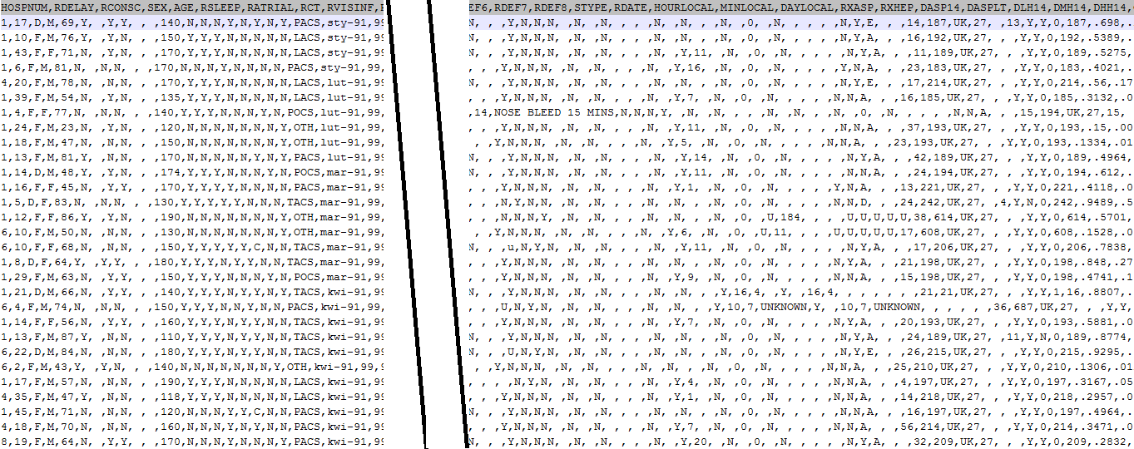
Variables
A comma-delimited data file
Units of
observation (cases)

Slide 19
What you need to know about a .csv file:
How many cases (rows) are there in this dataset? (Hint: scroll down and click on the last row. The number of the row is given by L[n] in the bottom ribbon of the screen)
Is the first row a row of variable names?
Are there blanks in the data, between commas (the delimiters)?
Are there blanks embedded among other characters in individual fields?
Are comment fields and/or other alphabetic variables enclosed in quotation marks?
Are full stops or commas used to indicate the decimal place in real numbers?
SPSS requires that decimal places be indicated with full stops.

Slide 20
Each variable must have a unique name:
each variables must be assigned a unique variable name, which must follow certain rules
Variable name: likeCameron
variables may optionally also have a variable label which provides a fuller description of the content of the variable.
variable labels are free text, up to 256 characters long, and are often used to give eg the text of a survey question (not recommended)
Variable label: How much do you like or dislike David Cameron

Slide 21
SPSS rules for variable names
variable names must be unique in the data file, ie occur only once
must start with a letter
can be up to 64 characters in length, but 8 characters or less is best
must not contain spaces/blanks, but may contain a few special characters such as full stop, underscore, and the characters $, #, and @
must not end with a full stop
should reflect the content of the variable, eg ‘age’, ‘age_grp’, ‘education’, ‘q1b_1’
some names have special meanings in SPSS (eg SYSMIS)
system variables begin with ‘$’, eg. $CASENUM, $DATE, $SYSMIS, etc – do not use these for regular variable names
do not use command names for variable names

Slide 22
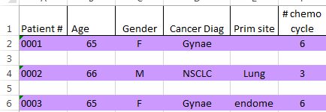
Not variable names

Slide 23
Good variable names
Note: original variables are not case sensitive (RespID=respid=RESPID), but new variables are case
sensitive (new variable Q2_r≠Q2_R≠q2_r)

Slide 24
Creating an SPSS system file from a raw data file
Metadata: where/how to read variables, variable names, variable labels, value labels, missing data specifications
Original data file
System file: temporary unless
you save it
Saved system file (.sav)

Slide 25
Creating an SPSS system file from a comma-delimited file
Drop-down menus: File > Read Text Data.
Navigate to Libraries > Documents > SPSS files > v3 > ist_corrected_uk1.csv
Click on ‘Open’.
The SPSS Text Import Wizard, a 6-screen sequence, determines how to read the .csv file with some input from you.
Remember the answers you gave to the questions in slide 19:
yes, you have a row of headers
no, a blank (aka ‘space’) is NOT a field delimiter in this file, only the comma is
no, there is no ‘text qualifier’.
SPSS will use your input and data in the first 200 cases to automatically compile a format specification for the file. NB if a field is longer in later cases, the content of the longer fields will be truncated to the longest width in the first 200 cases.
When successful (and error-free), SPSS will show:…

Slide 26
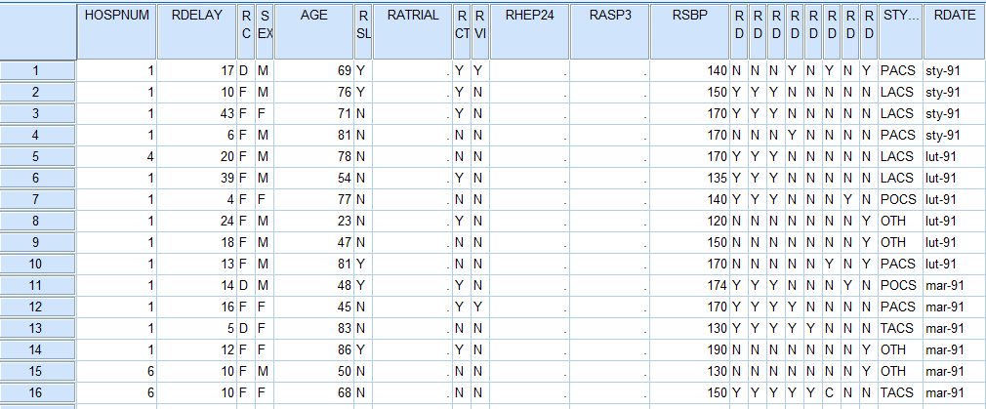
SPSS Data Editor : Data View window

Slide 27
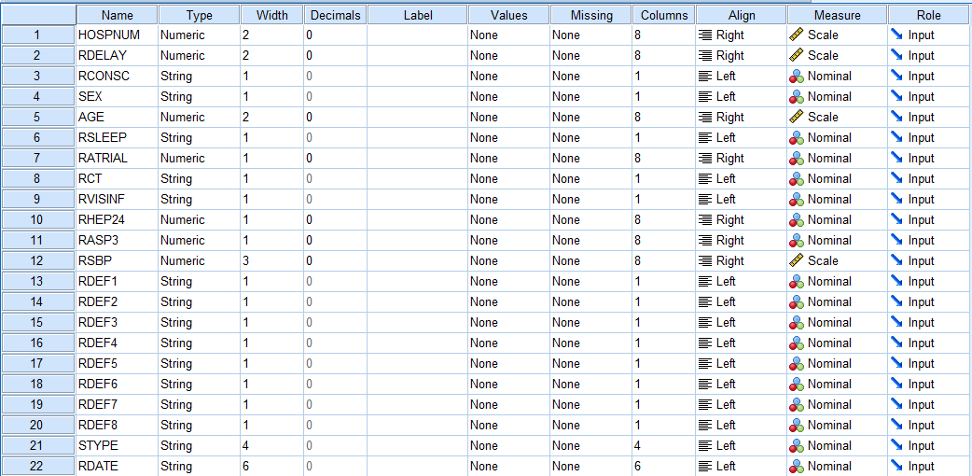
SPSS Data Editor : Variable View window

Slide 28
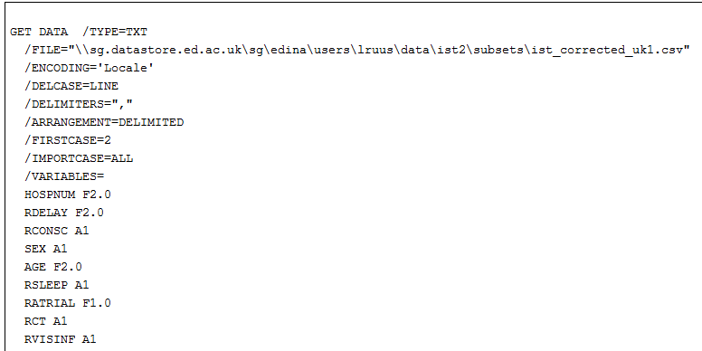
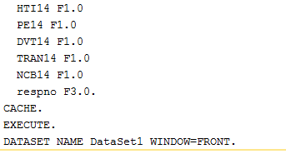
The Output1 [Document1] window – this is the syntax SPSS
used to read the .csv file
[lots of stuff deleted]

Slide 29
Checking the output:
check the Output window for Error messages,
click on the Data Editor window, and check both the Variable View, and the Data View, for anything that looks not quite right.
If there are error messages, try to figure out what the errors are.
Fix the first listed error first, and then rerun the job – errors often have a cascading effect, and fixing the first may eliminate later errors.

Slide 30
Checking the output (cont’d)
How many cases has SPSS read? Is this the same as the number of rows (minus 1) in the .csv data file?
Are there the same number of variable names and columns of data? (SPSS assigns the name ‘VAR[nnn]’ to unnamed variables.)
Does each column appear to contain the same type and coding range of data, even out to the far right of the Data View sheet?
Have variables containing embedded blanks, eg comment fields, been read correctly?
Do any variables (eg comment fields) appear to have been truncated?
Have numbers containing decimals been read correctly?

Slide 31
Saving the output:
Data file
File > Save as and save the data file with format ‘SPSS Statistics (*.sav)’.
Output log file ‘Output[n] [Document[n]] IBM SPSS Statistics Viewer’
use File > Export to save it in .txt, .html or .pdf format
Update the Data Log file

Slide 32
Common metadata management tasks in SPSS:
Add variable labels
Optimize variable labels for output
Add value labels to coded values, eg ‘1’ and ‘2’ for ‘male’ and ‘female’
Optimize value labels for output
Add missing data specifications, to avoid the inclusion of missing cases in your analyses
Change size (width) and number of decimals (if applicable)
Change variable measure type: nominal, ordinal, or scale
Rename variables

Slide 33
Adding metadata: variable and value labels, and user-defined missing data codes
Best done with a syntax file containing:
Data statement (if your file is eg fixed format) – in our example, SPSS took this information from the .csv file structure, so we don’t need one
Variable labels – eg survey question text, or description of content of each variable
Value labels –codes (numeric or alphabetic) used in each variable and what they mean
Missing values (user defined)
The alternative is to type this information in in the Variable View window, but this can be a lot of work, especially if you have a lot of variables.

Slide 34
You need syntax files when:
You want to make your analyses repetitive, i.e. easily reproducible on different or
changed data set
You want to have the option of correcting some details in your analysis path while
keep the rest unchanged
Some operations are best automated in programming constructs, such as IFs or LOOPs
You want a clear log of all your analysis steps, including comments
You need procedures or options which are available only with syntax
You want to save custom data transformations in order to use it them
later in other analyses
You want to integrate your analysis in some external application which uses the power
of SPSS for data processing
Source: Raynald’s SPSS tools <http://spsstools.net/en/syntax/>

Slide 35
Where do syntax files for reading in the data come from?
If you have collected your own data
You should write your own syntax file as you plan, collect and code the data.
Alternatively, some sites, such as the Bristol Online Surveys (BOS) site, will provide documentation as to what the questions in your survey were, and what the responses were, but you will likely have to reformat that information so that SPSS can read it.
If you are doing secondary analysis, ie using data from another source
If the data are from a data archive, that archive should also provide the syntax to read the file
If the data are from somewhere else, eg on the WWW, look to see if a syntax file is provided
Failing a syntax file, look for some other type of document that explains what is in each variable and how it is coded. You will then need to write your own syntax file.
And failing that, you should think twice about using the data, if you have no documentation as to how it was collected, coded, and what variables it contains, and how they are coded.

Slide 36
Advantages to using a syntax file:
a handful of commands/subcommands are available via syntax but not via the drop-down menus, eg temporary, missing=include, manova
for some procedures, syntax is actually easier and more flexible than using the menus (and vice versa.
perform with one click all the variable recoding/checking and labelling assignments necessary on a variable or group of variables
you can recycle text (cut and paste) to re-use the same set of syntax (the runs that worked, of course)
annotate with COMMENTS as a reminder of what each set of commands does, for future reference. COMMENTS will be included in your output files.

Slide 37
SPSS syntax rules
Commands must start on a new line, but may start in any column (older versions: column ‘1’)
Commands must end with a full stop (‘.’)
Commands are not case sensitive. Ie ‘FREQS’ = ‘freqs’
Each line of command syntax must be less than 256 characters in length
Subcommands usually start with a forward slash (‘/’)
Add comments to syntax (preceded by asterisk ‘*’ or ‘COMMENT’, and ending with a full stop) before or after commands, but not in the middle of commands and their subcommands.
Many commands can be truncated (to 3-4 letters), but variable names must be spelled out in full
Must use a full stop (‘.’) to indicate decimals

Slide 38
To generate syntax from SPSS:
If unsure about how to write a particular set of syntax, try to find the procedure via the drop-down menus
Many procedures have a ‘Paste‘ button beside the ‘OK’ button
Clicking on the ‘Paste’ button will cause the syntax for the current procedure to be written to the current syntax file, if you have one already open
If you do not have a syntax file open, SPSS will create one
Note: if you use the ‘Paste’ button, the procedure will not actually be run until you select the set of syntax and click the ‘Run’ button on the SPSS tool bar
Syntax can be edited, and ‘recycled’

Slide 39
To generate syntax from SPSS (cont’d):
Click the ‘Paste’ button to write the syntax to the syntax file file you have open, instead of running the procedure

Slide 40
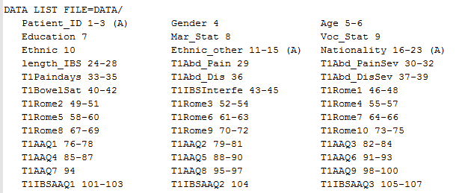
Data list statement for a fixed
field format file
Data list statement
For a .csv file with no
column headers

Slide 41
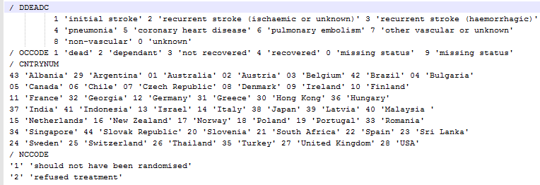
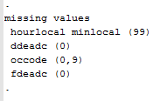
Variable labels section
Content of IST_labels.sps
Value labels section
String variables
Numeric variables
Missing values section

Slide 42
Adding variable and value labels, and user-defined missing data codes (cont’d)
In SPSS: File > Open > Syntax
Navigate to Libraries > Documents > SPSS files > ist_labels1.sps
Click and drag to select the syntax file contents, down to and including the full stop ‘.’ at the end of the file,
or Edit > Select All
click on the large green arrowhead (the ‘Run’ icon) on the SPSS tool bar
If no errors, you should now see variable and value labels and missing data specs in the Variable View window

Slide 43
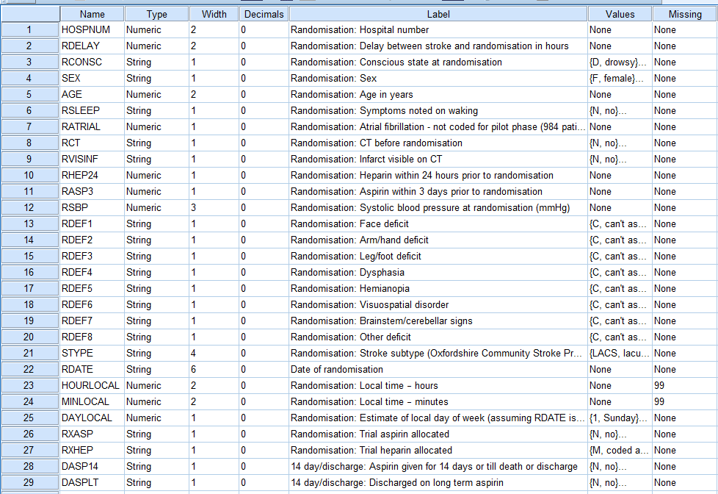

Slide 44
Missing values
Two types:
System missing – blanks instead of a value, ie no value at all for one or more cases (name=SYSMIS)
Note: $SYSMIS is a system variable, as in IF (v1 < 2) v1 = $SYSMIS. while SYSMIS is a keyword, as in RECODE v1 (SYSMIS = 99) (10 = SYSMIS).
User-defined missing – values that should not be included in analyses,
Eg “Don’t know”, “No response”, “Not asked”
Often coded as ‘7, 8, 9’ or ‘97, 98, 99’ or ‘-1, -2, -3’, or even ‘DK’ and ‘NA’
Note: String (alphabetic) values are case sensitive.

Slide 45
Missing values (cont’d):
User-defined missing can be recoded into system missing, and vice versa:
Recode to system missing:
recode rdef1 to rdef8 (‘Y’=1)(‘N’=0)(‘C’=sysmis) into rdef1_r rdef2_r rdef3_r rdef4_r rdef5_r rdef6_r rdef7_r rdef8_r.
execute.
Recode to user-defined missing:
recode fdeadc (sysmis=9)(else=copy) into fdeadc_r.
execute.

Slide 46
Variable view window used to look
like this
And now looks like this

Slide 47
Displaying and saving dataset content information
To produce a variable list in your output file that can be copied into your Data log file
select File > Display Data File Information > Working File
alternatively, using syntax: display dictionary.
in Output Viewer window:
Click on Variable Information
Ctrl-C to copy
Ctrl-V to paste onto a new sheet in the Data Log file
do the same with the Value Labels list in Output Viewer window
Why should you do this?
So that you have a record of what variables and values were in the original data file
Provides a convenient template for documenting variable transformations such as recodes, and new computed variables
Provides a convenient template for documenting missing data assignments, etc

Slide 48
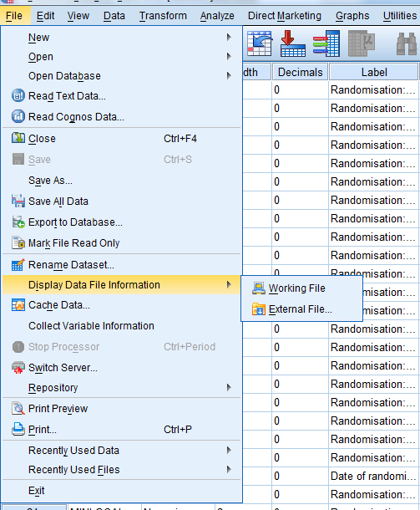
Displaying and saving
dataset content information
(cont’d)

Slide 49
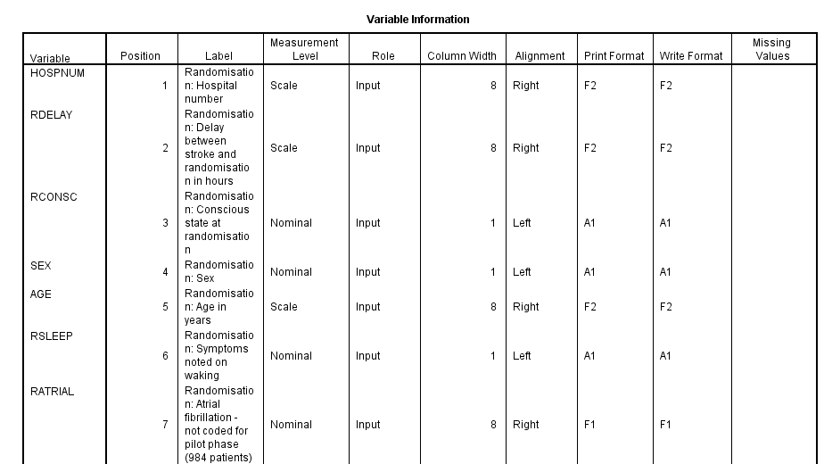
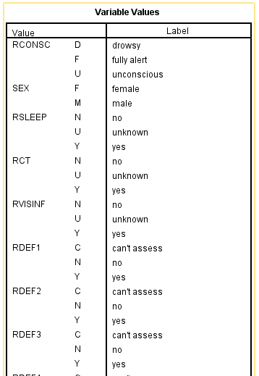
Variable Information list
Content of Output window
Copy and paste this info into
the Data log file
Value Labels list

Slide 50
Checking the variables: basic descriptive statistics
Why run descriptive statistics?
Check how values are coded and distributed in each variable
Identify data entry errors, undocumented codes, string variables that should be converted to numeric variables, etc
Determine what other data transformations are needed for analysis, eg recoding variables (eg the order of the values), missing data codes, dummy variables, new variables that need to be computed
After a recode/compute procedure, ALWAYS check resulting recoded/computed variable against original using FREQUENCIES and CROSSTABS

Slide 51
Descriptive statistics (cont’d)
Four ways to produce univariate descriptive statistics:
In Data view or Variable view window (numeric variables, <50 values)
click on a variable name to select it
R-click (ie click the Right mouse button)
select Descriptive statistics

Slide 52
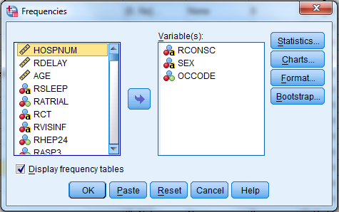
Descriptive statistics (cont’d)
2. Using drop-down menus (numeric or string variables, incl >50 values):
Analyse > Descriptive statistics > Frequencies
Select one or more variables from the window on the left, and move them to the window on the right
Click the ‘OK’ button
Icon for string (alphabetic) variable
Icon for categorical (numeric) variable

Slide 53
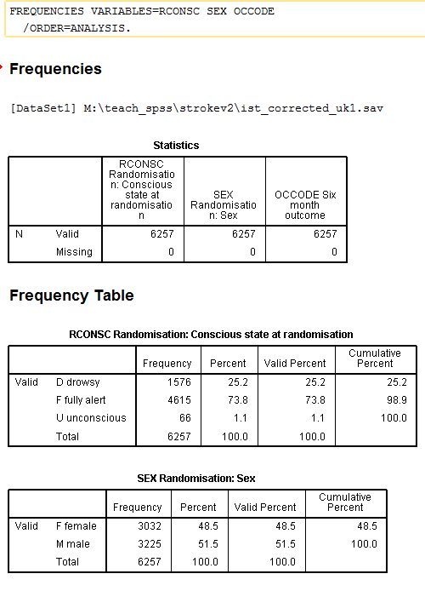
Output from FREQUENCIES
for categorical and string variables

Slide 54
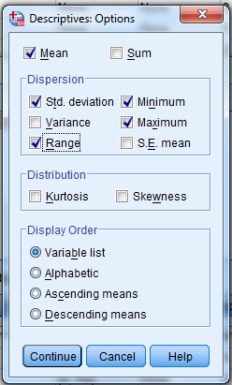
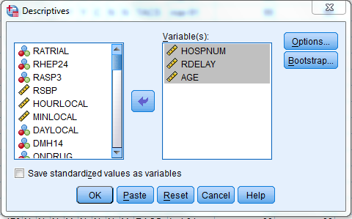
Descriptive statistics (cont’d)
3. Using drop-down menus (scale/continuous variables):
Analyse > Descriptive statistics > Descriptives
Select one or more variables from the window on the left, and move them to the window on the right
Select appropriate Options
Click the ‘OK’ button
Icon for scale (continuous) variable

Slide 55
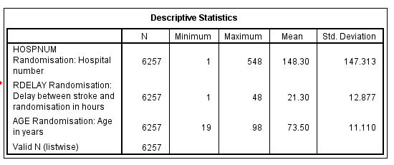
Descriptive statistics (cont’d)
Output from DESCRIPTIVES
command for
scale/continuous or categorical variables
with Options selected

Slide 56
Descriptive statistics (cont’d)
4. Using syntax:
Categorical and string (alphabetic) variables:
FREQUENCIES VARIABLES=age
/ MISSING=INCLUDE.
Scale (continuous) and categorical variables:
DESCRIPTIVES VARIABLES=age
/ STATISTICS=MEAN STDDEV MIN MAX RANGE
/MISSING=INCLUDE.
Nb. ‘Missing=include’ option only available in syntax. Earlier versions of SPSS required it, but as of SPSS 21+, it seems to be no longer required. Missing values are displayed by default in the frequencies output.
Try both commands.
Look at the differences in output.

Slide 57
Descriptive statistics (cont’d)
Continuous variable in ‘frequencies’ (default options)
Continuous variable in ‘descriptives’ (default options)

Slide 58
Descriptive statistics (cont’d)
What is the mean of the AGE variable? Can you get this from Frequencies or Descriptives?
What is the median of the AGE variable? Can you get this from Frequencies or Descriptives?
What is the mode of the AGE variable? Can you get this from Frequencies or Descriptives?
What is the standard deviation of the AGE variable? Can you get this from Frequencies or Descriptives?

Slide 59
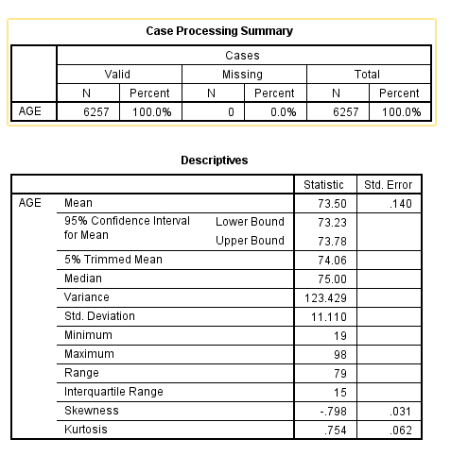
Descriptive statistics (cont’d)
Menus:
Analyse > Descriptive statistics > Explore
Syntax:
Examine variables=age.

Slide 60
Common recoding tasks, ie recoding existing variable(s)
Convert string variables to numeric
Change order of values of variables (nominal → ordinal)
Change system missing to user-defined missing or vice versa
Collapse categories
Replace missing values with eg variable mean
Creating dummy variables

Slide 61
Common recoding tasks (cont’d)
Methods:
Drop-down menus
Transform > Automatic Recode
Transform > Recode into Different Variables
Transform > Recode into Same Variable <– NEVER, NEVER, NEVER use this!!
Transform > Create dummy variables
Syntax
Automatic recode
Recode
Recode (convert)

Slide 62
Recoding an existing variable: automatic recode
Advantages of automatic recode
Will recode a string variable to a numeric variable
All variable and value labels and missing data specifications, if available, are transferred from old variable to new variable
Very easy
Disadvantages
Numeric values assigned in alphabetic order of string variables
No control over order of values in recoded variable

Slide 63
Recoding an existing variable: automatic recode (cont’d)
Drop-down menus:
Transform > Automatic Recode
Syntax:
AUTORECODE VARIABLES=
sex rsleep rct rvisinf rdef1 to stype / into sex_r rsleep_r rct_r
rvisinf_r rdef1_r rdef2_r rdef3_r rdef4_r rdef5_r
rdef6_r rdef7_r rdef8_r stype_r
/ BLANK=MISSING / PRINT.

Slide 64
Caution when using Automatic Recode
Original string variable like this:
Will be recoded to this:

Slide 65
Recoding an existing variable: recode into different variables
Advantages
Complete control over values and order of values in recoded variable
If you make a mistake, you can correct the error and repeat
Can recode an original variable into several different variables, as appropriate, eg a dummy or series of dummy variables, a component of a scale, collapse categories in different ways
Disadvantages
Variable and value labels, etc, are NOT transferred to new variable, and must be added ‘manually’

Slide 66
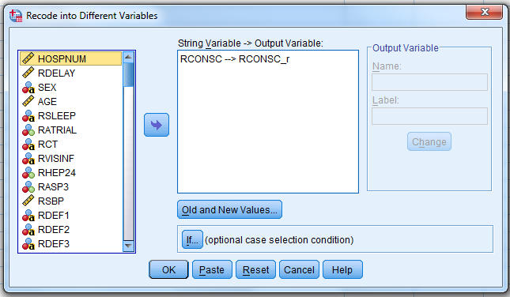
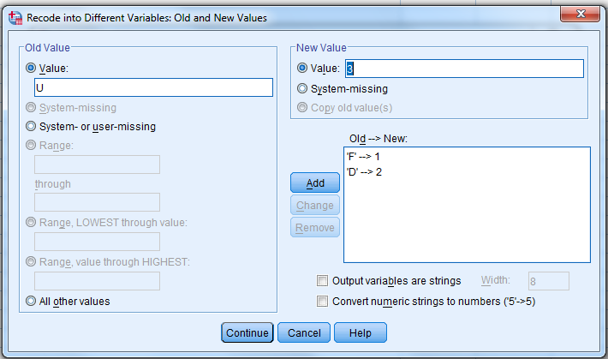
Recoding an existing variable: recode into different variables
Drop-down menus:
Transform > Recode into Different Variables
Syntax
RECODE rconsc ('F'=1) ('D'=2) ('U'=3) INTO rconsc_r.
EXECUTE.

Slide 67
Recoding an existing variable: recode (convert)
If a variable has been classed as string because of some non-numeric codes, but otherwise consists of numbers (eg: 1, 2, 3, 4 , 5,…,69, dk, na):
Drop-down menus: Transform > Automatic Recode (slides 57 & 58)
Syntax: use the ‘CONVERT’ option to the RECODE command, eg
RECODE yra (CONVERT) ('DK' = 98) ('NA' = 99) INTO yra_r.
EXECUTE.
Advantages
Explicitly specify only the codes you want to change, none of the other (numeric) ones
Unlike automatic recode, this preserves the natural order of numbers
Disadvantages
None I can think of

Slide 68
Common compute operations:
Create a unique respondent or record identifier
Compute eg an index variable from a group of related variables
Create a new variable from part of an existing variable
Creating a weight variable from existing variables

Slide 69
Computing a new variable
E.g. create a new, unique case identifier variable, if the data set doesn’t have one:
COMPUTE respid=$CASENUM.
FORMAT respid (F8.0).
EXECUTE.
Create a scale (continuous) variable as sum of values of existing variables:
RECODE rdef1 to rdef8 (‘Y’=1)(‘N’=0)(‘C’=SYSMIS) INTO rdef1_r rdef2_r rdef3_r rdef4_r rdef5_r rdef6_r rdef7_r rdef8_r.
COMPUTE deficits=SUM(rdef1_r,rdef2_r,rdef3_r,rdef4_r,rdef5_r,rdef6_r,rdef7_r,rdef8_r).
FREQUENCIES deficits.

Slide 70
Computing a new variable from part of a string variable
See variable ‘rdate’ on slide 24, coded as ‘lut-91’, ‘mar-91’, ‘sty-91’, etc (ie month (Polish)-year)
An example of stripping out part of a string variable and recoding to numeric format:
* Declare a new string variable ‘montha’.
string montha (a3).
*Compute the new variable=the 1st 3 characters of the original variable ‘rdate’.
compute montha=(substr(rdate,1,3)).
* Recode the new variable ‘montha’ into a numeric variable ‘rmonth’ and assign labels.
recode montha ('sty'=1)('lut'=2)('mar'=3)('kwi'=4)('maj'=5)('cze'=6)
('lip'=7)('sie'=8)('wrz'=9)('lis'=11)('gru'=12)(else=10) into rmonth.
variable labels rmonth 'Month of randomization - recoded from rdate'.
value labels rmonth
1 'January' 2 'February' 3 'March' 4 'April' 5 'May' 6 'June'
7 'July' 8 'August' 9 'September' 10 'October' 11 'November' 12 'December'.
* Check the new numeric variable.
frequencies variables=rdate montha rmonth.

Slide 71
Computing a new variable from part of a string variable (cont’d)
We can do something similar with the year component of the variable ‘rdate’:
* Declare a new string variable ‘yra’ 2 characters in width.
string yra (a2).
* Compute a new string variable ‘yra’ starting after the dash and 2 characters long.
compute dash = index(rdate,'-').
compute yra = substr(rdate,dash+2).
* Recode the new variable ‘yra’ into a numeric variable ‘yr’.
recode yra (convert) into yr.
* Compute a new 4-digit numeric variable ‘ryear’.
compute ryear=(1900+yr).
format ryear (f4.0).
* Label the new variable, and check the frequencies.
variable labels ryear 'Year of randomization - recoded from rdate'.
frequencies variables=yra yr ryear.

Slide 72
New variables need metadata, ie labels & missing data specifications
Alternative 1: enter the information in the Variable View window
Alternative 2: create a syntax file with the info, and run it
NB: new variables are added at the end of the existing variables in the data file
NNB: new variables are by default 8 columns in width, with 2 decimal places, unless you specify another format

Slide 73
Recoded/computed variables also need to be checked - frequencies
Frequencies syntax:
recode fdeadc (sysmis=9)(else=copy) into fdeadc_r.
execute.
format fdeadc_r (f1.0).
missing values fdeadc_r (9).
frequencies fdeadc fdeadc_r .
Note: frequencies output includes user-defined and system missing values.

Slide 74
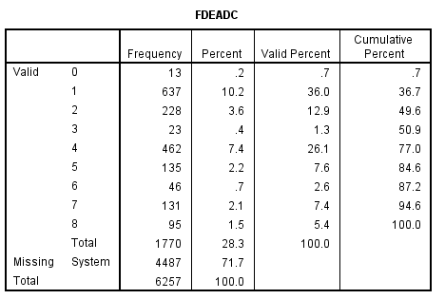
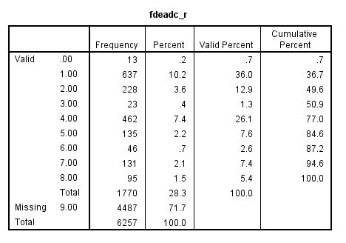
Recoded/computed variables need to be checked – frequencies output
System missing
User defined missing

Slide 75
Recoded/computed variables need to be checked - crosstabulations
Crosstabs syntax example:
recode fdeadc (sysmis=9)(else=copy) into fdeadc_r.
execute.
format fdeadc_r (f1.0).
missing values fdeadc_r (9).
frequencies fdeadc fdeadc_r .
crosstabs tables=fdeadc by fdeadc_r / missing=include.
Note: crosstabs output displays user-defined (but not system-missing) missing values with
/missing=include subcommand.

Slide 76
Recoded/computed variables need to be checked – crosstabs output
User defined missing
Note: system-missing cases are NOT included

Slide 77
You can run all 7 function in one go with syntax:
So now the full syntax for this one recode looks like this:
recode fdeadc (sysmis=9)(else=copy) into fdeadc_r.
execute.
format fdeadc_r (f1.0).
variable labels fdeadc_r 'Cause of death - recoded'.
value labels fdeadc_r
1 'initial stroke' 2 'recurrent stroke (ischaemic or unknown)'
3 'recurrent stroke (haemorrhagic)' 4 'pneumonia'
5 'coronary heart disease' 6 'pulmonary embolism'
7 'other vascular or unknown‘ 8 'non-vascular'
0 'unknown' 9 'not coded'.
missing values fdeadc_r (0,9).
frequencies fdeadc fdeadc_r .
crosstabs tables=fdeadc by fdeadc_r / missing=include.

Slide 78
Update the data log file – new variable information

Slide 79
Update the data log file – new variable and value information

Slide 80
Adding variables from another data file
First, check the existing data file, and the file from which you are adding variables
Both files must be SPSS system files (.sav extensions)
Both files must be sorted in the same order (Data > Sort Cases)
Both files must have a unique case identifier variable (key variable)
Both case identifier names must be the same (including same case, ie upper/lower)
Both case identifier variables must be the same type (string or numeric)
Both case identifier variables must be the same width
Any duplicate variable names must be renamed

Slide 81
Adding variables (cont’d)
The *_uk1.sav file
The *_uk2.sav file

Slide 82
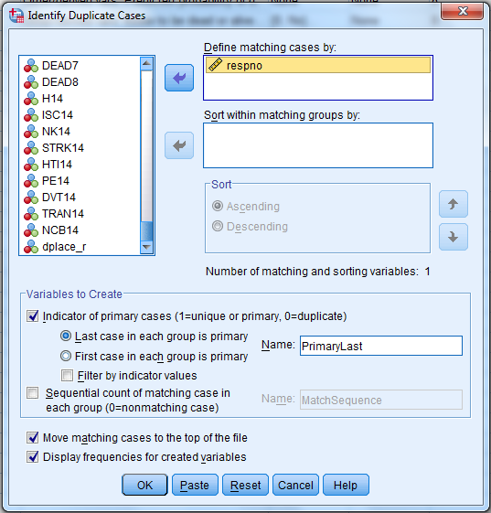
To check whether the respondent identifier variable is unique in each file
Select Data > Identify Duplicate Cases
Select the respondent identifier variable and
move to ‘Define matching cases by’ box
Click ‘OK’
Doing this with syntax is much more involved
Output

Slide 83
Adding variables (cont’d): drop-down menus
Data > Merge Files > Add Variables
Select an already open SPSS system file, or an external file, as appropriate
Select ‘Match cases on key variables’
Move the case id variable from ‘Excluded variables’ to ‘Key variables’
Click ‘OK’
Check and save output data file

Slide 84
Adding variables (cont’d): syntax
*Merging ist_corrected_uk1.sav, and ist_corrected_uk2.sav on 'respno'.
DATASET CLOSE All.
MATCH FILES FILE= "[path]\ ist_corrected_uk1.sav "
/FILE="[path]\ist_corrected_uk2.sav "
/BY respno.
EXECUTE.
SAVE OUTFILE ="[path]\ ist_corrected_uk.sav" / KEEP=all / MAP.
This subcommand produces a list of all the variables in the saved data file

Slide 85
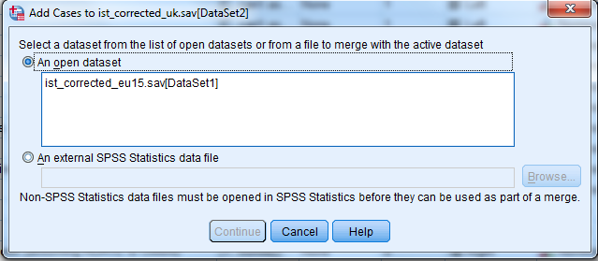
Adding cases from another data file: drop-down menus
Open the ‘ist_corrected_eu15.sav’ (File > Open > Data)
Select Data > Merge files > Add cases
Note: recodes performed in ist_corrected_uk.sav’ will NOT be applied across the added cases.

Slide 86
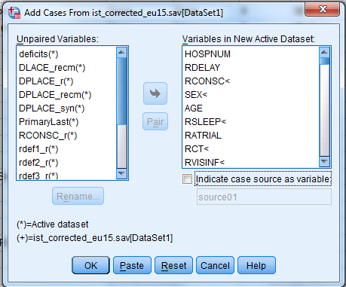
Adding cases: drop-down menus (cont’d)
Variables must match on several aspects in order to be ‘paired’ between the two files:
the variable names match is case sensitive,
both variables in both files must be the same type (string or numeric); string variables are flagged by ‘>’,
variables must have the same width
unpaired variables can be added to the output dataset, but will have missing values for records in which they do not occur.

Slide 87
Adding cases: syntax
*Add EU15 cases.
DATASET ACTIVATE DataSet2.
ADD FILES /FILE=*
/RENAME (deficits DLACE_recm DPLACE_r DPLACE_recm DPLACE_syn PrimaryLast
RCONSC_r rdef1_r rdef2_r rdef3_r rdef4_r rdef5_r rdef6_r rdef7_r rdef8_r SEX_r=d0 d1
d2 d3 d4 d5 d6 d7 d8 d9 d10 d11 d12 d13 d14 d15)
/FILE='DataSet1'
/DROP=d0 d1 d2 d3 d4 d5 d6 d7 d8 d9 d10 d11 d12 d13 d14 d15.
EXECUTE.
SPSS’s default is to first rename all unmatched variables, and then DROP them from the resulting merged file

Slide 88
Moving data among formats
Several options:
Software packages such as StatTransfer convert data files among a wide variety of different software dependant and generic formats (with/without syntax files to read into other formats). The Data Library has StatTransfer and can help with this.
Software packages such as SledgeHammer, and Colectica will write a generic format (usually .csv) and a DDI-standard .xml metadata file. The Data Library has SledgeHammer, and can help with this.
Many statistical software packages can read in an SPSS system file (*.sav)
Use SPSS menus: File > Save as to write tab-delimited, comma-delimited (*.csv), or fixed field ascii formats
Use SPSS syntax to write out one of a number of other software-specific output formats (see Appendix D of the workshop handout)
NB: SPSS no longer writes SPSS syntax files

Slide 89
Outputting the data in a generic format: drop-down menus
File > Save as

Slide 90
Writing out the data in a generic format: syntax
DISPLAY DICTIONARY.
WRITE OUTFILE='C:\Temp\ist2_uk.txt' TABLE
/ hospnum to respno.
EXECUTE.
Note: you can rearrange the order of variables by listing them in the desired output order after the ‘/’
You MUST save the TABLE from the output file…this will be your only clue as to where variables are located in the output fixed field format data file.
Check the file: open the output data file in a format neutral editor which will give you a count of the cases and record lengths written
Save the output data file and the output log file and update the Data log file.

Slide 91
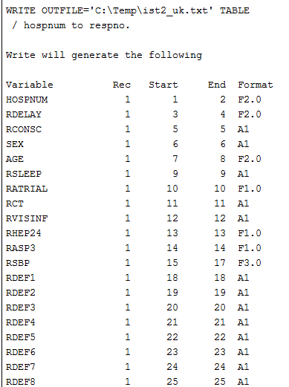
Output from WRITE command with the
TABLE option

Slide 92
Saving the files
SPSS Data file (Data View/Variable View window)
File > Save as > SPSS system file (.sav extension)
SPSS Output viewer window
File > Export as > [prefer text, html or PDF formats)
SPSS Syntax file (a flat ASCII text file)
File > Save as > SPSS syntax file (.sps extension)
Data log file
File > Save as > [name and extension appropriate for the software you have used]

Slide 93
If you remember nothing else from this session:
You must always be able to backtrack through the versions of the data, therefore:
NEVER, NEVER, NEVER overwrite an existing variable when recoding or computing. ALWAYS recode or compute to a new variable name.
ALWAYS, ALWAYS, ALWAYS save each version of the data file under a new name (ie NEVER overwrite the old dataset) after variable and file transformations, eg
20160202.mydatafile.sav
20160203.mydatafile.sav
Keep your Data log file up-to-date
And, for support, Google is your friend (see also Appendix A in the workshop handout)

Slide 94
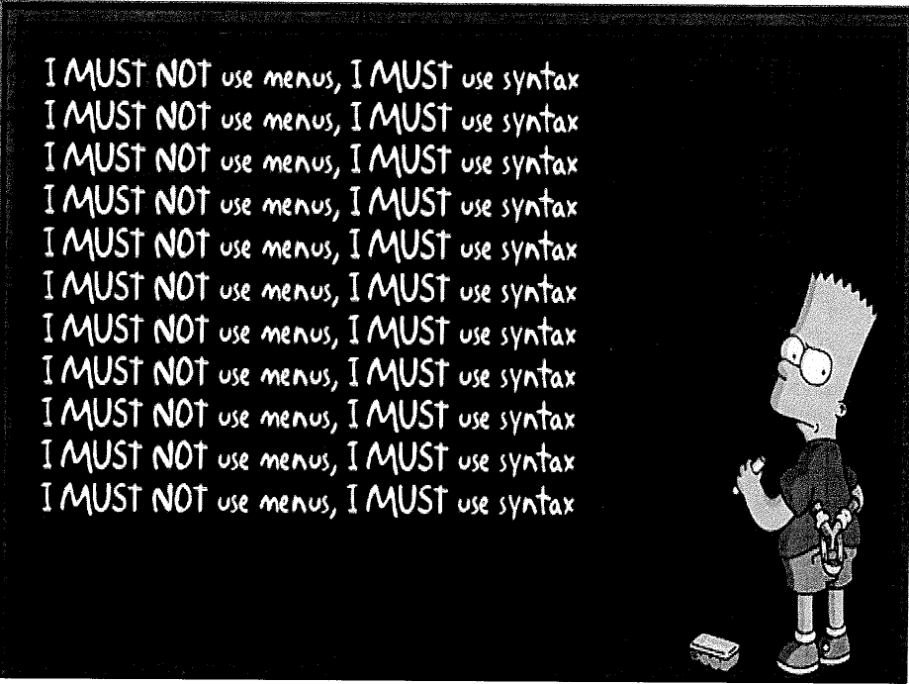

Slide 95
What questions do you have?

