Slide 1
Evaluating statistics on the web
Laine G.M. Ruus
University of Toronto Data Library – retired
2017-10-04

Slide 2
https://www.statista.com/chart/11240/people-worried-about-fake-content-on-the-web/
Notes:
A survey of 17 countries, including Canada. We can conclude that Canada is one of the bottom 7 countries on this scale.
Will revisit later.

Slide 3
What are statistics?
Descriptive statistics provide simple summaries about the sample and about the observations that have been made. Such summaries may be either quantitative, i.e. summary statistics, or visual, i.e. simple-to-understand graphs.
Source: Marshall, Gordon/ A dictionary of sociology. 2nd ed. Oxford: Oxford University Press, 1998.

Slide 4
What are statistics (cont’d)
Inferential statistics [are] statistics which permit the researcher to demonstrate the probability that the results deriving from a sample are likely to be found in the population from which the same has been drawn.
Source: Marshall, Gordon/ A dictionary of sociology. 2nd ed. Oxford: Oxford University Press, 1998.

Slide 5
Data
Notes:
One method of storing raw data.
Data set has 990 lines, 495 respondents.

Slide 6
Also data
Employment insurance (EI)
tracking survey 2011
http://www.edsc-esdc.gc.ca/ouvert-open/bca-seb/ae-ei/2011_Dataset_EITracking2011CSV.csv
Notes:
Data from the Canadian Open Government portal mainly in .xls format

Slide 7
Descriptive statistics
http://www.statcan.gc.ca/pub/11-626-x/11-626-x2015046-eng.pdf
Notes:
Data from Canadian Community Health Survey and the General Social Survey
Data for this study are taken from the five cycles of the GSS fielded from 2009 to 2013 and the four cycles of the CCHS fielded from 2009 to 2012 inclusive. CCHS and GSS respondents were asked:1
Using a scale of 0 to 10, where 0 means “Very dissatisfied” and 10 means “Very satisfied”, how do you feel about your life as a whole right now?

Slide 8
Inferential statistics
http://www.statcan.gc.ca/pub/11-626-x/11-626-x2015046-eng.pdf
Notes:
Data from Canadian Community Health Survey and the General Social Survey
Data for this study are taken from the five cycles of the GSS fielded from 2009 to 2013 and the four cycles of the CCHS fielded from 2009 to 2012 inclusive. CCHS and GSS respondents were asked:1
Using a scale of 0 to 10, where 0 means “Very dissatisfied” and 10 means “Very satisfied”, how do you feel about your life as a whole right now?

Slide 9
Statistics ≠ data
Data are the raw observations at the level at which they were originally collected, eg person by person, tree by tree, stock transaction by stock transaction, rainfall at time point 1, 2, 3, etc
Descriptive statistics are numeric summaries of common characteristics of those raw observations
Inferential statistics are assumptions about the characteristics of the population from which the sample was drawn, based on the characteristics of the sample
‘Data’ is not the plural of ‘anecdote’!
Note: Most “data” available under Open Data initiatives are statistics or metadata, not data per se.

Slide 10
Axiom
Good research requires good data
of which one corollary is
Good statistics require, first, good data

Slide 11
Evaluating statistics
Quality of statistics depends on:
The data from which they are computed
The analysis used to compute them
The presentation
The interpretation, if applicable
Evaluating statistics on the web is no different from evaluating statistics from any other source

Slide 12
A: The interpretation
If there is an interpretation, does the interpretation agree with the statistics provided?
Who provided the interpretation – what is their purpose, their point of view?
Notes:
Governments are the only agencies capable of surveying entire populations.
In principle, they should be free of political influence, and therefore their interpretations are generally considered to be unbiased.

Slide 13
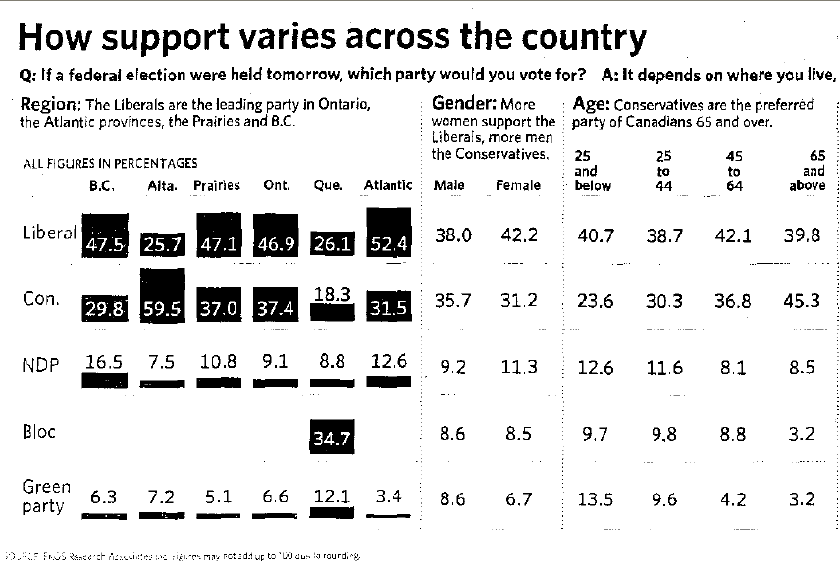
Does the interpretation match the statistics presented?
100%
100%
Source: Toronto Star, Dec. 9, 2006

Slide 14
The state of homelessness in Canada 2016
http://homelesshub.ca/sites/default/files/SOHC16_final_20Oct2016.pdf
Notes:
Promoting concern for a social issue(s).
How would one collect data on homelessness
Number of shelter users not mentioned?
Pictogrammes are disproportionate

Slide 15
B: The presentation
Three major types of presentation
Traditional tables of univariate or multivariate crosstabulations
Statistics embedded in text
Visualisations

Slide 16
This is 3 bi-variate tables
Source: Toronto Star, Dec. 9, 2006
Notes:
Cardinal rule of categorical variables broken! Which column are the 25 year old in?

Slide 17
This is 4 tables
http://www.statcan.gc.ca/pub/11-626-x/11-626-x2015046-eng.pdf
Notes:
Data from Canadian Community Health Survey and the General Social Survey
Data for this study are taken from the five cycles of the GSS fielded from 2009 to 2013 and the four cycles of the CCHS fielded from 2009 to 2012 inclusive. CCHS and GSS respondents were asked:1
Using a scale of 0 to 10, where 0 means “Very dissatisfied” and 10 means “Very satisfied”, how do you feel about your life as a whole right now?

Slide 18
Tables
Tables of numbers can be difficult to read
Interleaving a number of different characteristics in a table can make it more difficult to read
Difficult to identify patterns in the data
Labels should be on the left
Numeric values should be right aligned, or aligned on the decimal point
Should have totals, either at the bottom or in the right-most column, where appropriate
Notes:
Tables are a common presentation format for government agencies which collect data, eg statistical agencies, NGOs etc

Slide 19
Note re reading tables
Percentages, proportions and rates can be compared only within the row/column in which they have been computed (eg add up to 100%)
Counts, relative proportions or likelihoods can be compared between rows/columns.

Slide 20
Statistics embedded in text
Eg 1: “According to a survey by the BBC, only 14 percent are very perturbed by content possibly being fake. Another 33 percent are somewhat worried. So, while 47 percent overall are worried to some degree, this is a low figure compared to how worried people in other countries are. In Brazil, most people are concerned: 92 percent are worried about what's real and what's fake.”
https://www.statista.com/chart/11240/people-worried-about-fake-content-on-the-web/

Slide 21
Source: The state of homelessness in
Canada 2013
http://homelesshub.ca/sites/default/files/SOHC2103.pdf

Slide 22
Statistics embedded in text (cont’d)
“…how much less likely are normal people to shower during a thunderstorm? I think this is somewhere between 10x and 100x. Lots of people have heard that it is dangerous to shower during a thunderstorm and will avoid it. But some storms start while people are showering, others might not be aware that a storm is happening, and others will just risk it. I'll say 50x to be conservative.
Putting all this together, you have about 50*24*0.013/(100 million) = 16 deaths per 100 million for someone who takes an extra shower during a thunderstorm.”
http://www.independent.co.uk/news/science/is-it-safe-to-take-a-shower-during-a-thunderstorm-9966031.html

Slide 23
Statistics embedded in text
Highlight author’s focus
Seldom provide the complete picture
Are selected to support the author’s argument
Least useful are those that mix counts, percentages, and/or ratios in one argument

Slide 24
‘Data’ visualisation
Is the type of visualisation appropriate to the type of statistics?
Parts of a whole: pie chart, stacked bar chart
Comparing groups, eg gender, marital status, other categorical variables: bar chart or histogram
Time series: line charts
Geospatial: maps

Slide 25
Student ratings of food masculinity, healthiness and palatability, 2015 http://stats.datalib.edina.ac.uk/sda/
Notes:
A self-selected sample (ie not random) and cannot therefore make assumptions about any population.
One table – 3 visualisations, stacked bar chart, bar chart, pie chart

Slide 26
Source: The homeless hub/ The picture isn’t pretty.
http://homelesshub.ca/blog/picture-isnt-pretty

Slide 27
https://www.statista.com/chart/11296/existing-and-proposed-income-tax-rates-in-the-united-states/
Notes:
Source: NYT – inadequate
Unclear where error in category boundaries originated.

Slide 28
https://www.statista.com/chart/11115/beer-poured-at-munich-oktoberfest-and-gross-revenue-generated-from-beer-sales/
Notes:
Two sets of statistics on one chart
5 left circles are smaller (16 mm) than the 4 right circles (18 mm) , even tho some numbers on the right are smaller than those on the left. Misleading impression of more beer poured in 2014-2017
Bar chart should have been adjusted for inflation for comparison purposes.

Slide 29
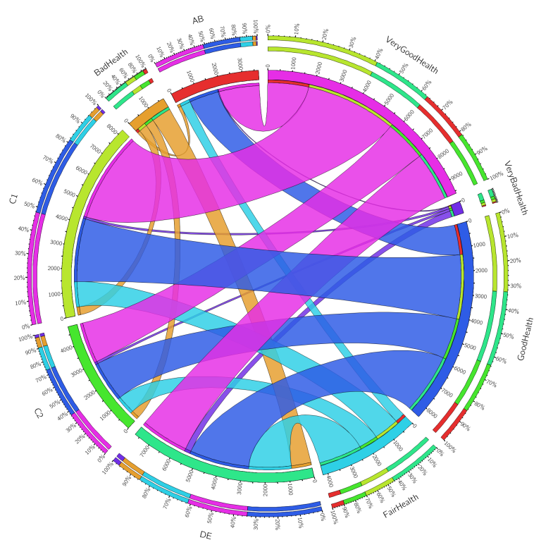
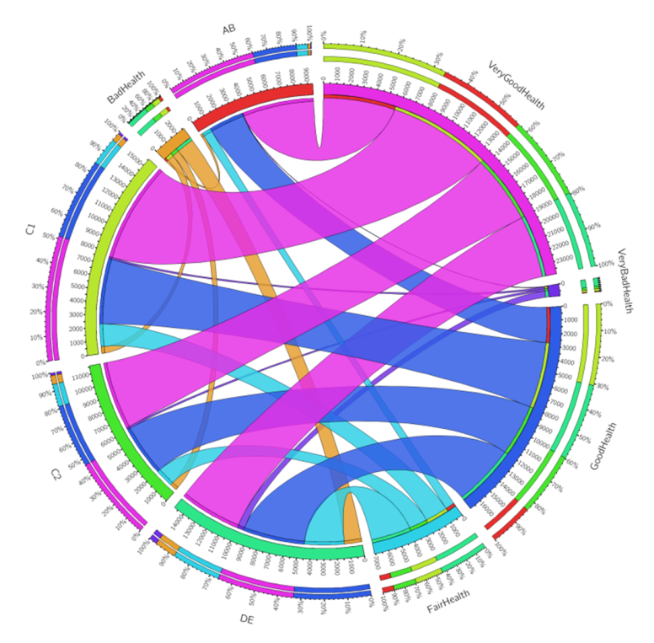
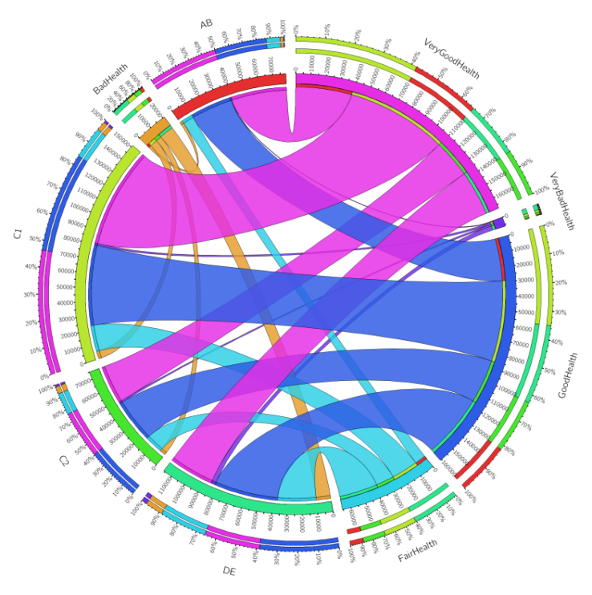
Is there a relationship between
perceived health and social
grade in the countries of Great
Britain?
Scotland
England
Wales
Source: UK census, 2011 (1% sample microdata file) - merged file
Notes:
Circos.ca – tabular visualisation software

Slide 30
http://www12.statcan.gc.ca/census-recensement/2011/geo/map-carte/pdf/thematic/LANG/2011-98313-005-535-013-17-01-eng.pdf

Slide 31
Selected tips for evaluation visualisations:
Source of data should be clearly labelled
Are numbers accurately labelled? What about interpolations and/or extrapolations?
Pie charts should be based on percentages, fractions, ratios, or decimals, but not amounts
Left-right and up-down orientation should follow conventions of your audience
XY charts should start at zero (or below where appropriate
Scale divisions should be the same size
Type of measurement and unit of measure should be clear

Slide 32
C: The analysis
Are the statistics first-hand, or post-processed? May there have been mistakes in the post-processing?
When the statistics are rates, ratios, percentages, proportions, what’s in the denominator is as important as what’s in the numerator
Are variable relationships logical?

Slide 33
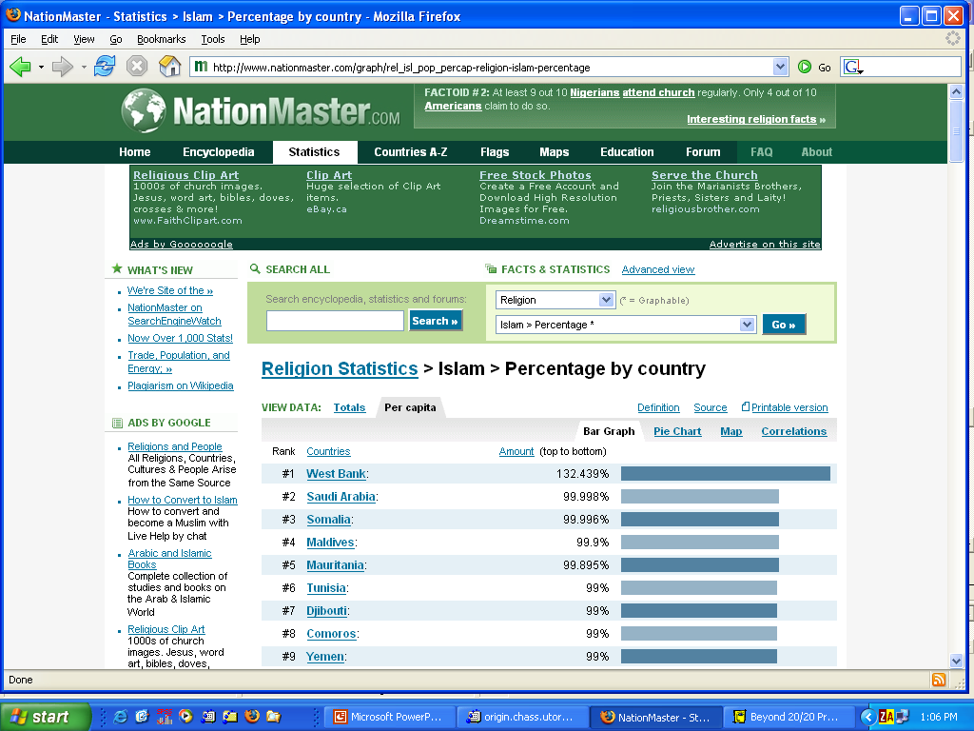
http://www.nationmaster.com
Notes:
Post-processed data.
Algorithm issue
See www.nationmaster.com for corrected version: Religion > Islam > Percentage Muslim: Countries Compared

Slide 34
https://www.statista.com/chart/11135/top-10-governmental-contributors-to-the-budget-of-the-unhcr/
Notes:
One graph, 3 variables.

Slide 35
https://www.statista.com/chart/11127/countries-with-the-highest-per-capita-donations-for-the-unhcr/
Notes:
What a difference a denominator makes.
1 graph, 3 variables.

Slide 36
https://www.statista.com/chart/11096/racial-wealth-inequality-is-rampant-in-the-us/
Notes:
Con:
Third hand data: neither Prosperity Now nor Institute for Policy Studies has capacity to collect these data. The original data can only come from one of US government surveys
- inadequate citations – comparable to citing a book published by Penguin, or Oxford University Press
-- Y-axis categories are the same size, but the X-axis ones are not
-- Time series data points are not all labelled
Pros
time line ok for forecasts
Y-axis starts at ‘0’

Slide 37
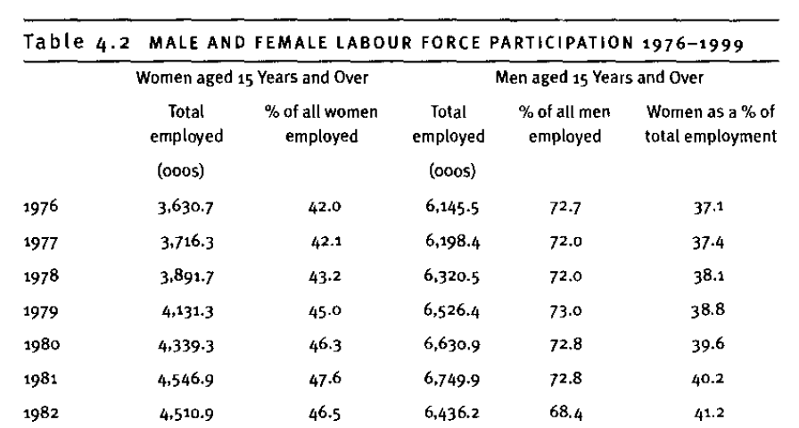
Here’s what the academic called the table

Slide 38
And this is what the original Statistics Canada publication called
the same table:
Source: Women in Canada. STC cat no. 89-503, pl. 116
Notes:
Same table as previous, but different titles. Which one would you use?

Slide 39
Employment rate and participation rate are not the same thing:
http://www12.statcan.gc.ca/census-recensement/2006/ref/dict/pop029-eng.cfm
http://www12.statcan.gc.ca/census-recensement/2006/ref/dict/pop108-eng.cfm

Slide 40
D: The data
What do you know about how the data were collected?
From whom/what were they collected
Was it a sample or a census (a 100% sample)
How was the sample selected
Representative sample: random sample, RDD
Non-representative sample: walk-by poll, pre-compiled panel, self-selected sample
How was/were the data collected, in what order were questions asked

Slide 41
From whom/what/where were the data collected?
Eg: “The results are drawn from a survey of 16,542 adult citizens across 18 countries, including 11,799 Internet users, conducted for BBC World Service by the international polling firm GlobeScan and its research partners in each country. GlobeScan coordinated fieldwork, involving telephone and in-person interviews, between 13 January and 27 April 2017. In five of the 18 countries, the sample was limited to major urban areas. The margin of error per country ranges from +/- 2.9 to 3.9 percent.”
http://www.bbc.co.uk/mediacentre/latestnews/2017/bbc-world-service-poll
Notes:
Can’t find this info on the GlobeScan web site, but it is on the BBC web site

Slide 42
http://www.bbc.co.uk/mediacentre/latestnews/2017/bbc-world-service-poll

Slide 43
Notes:
The visualisations

Slide 44
http://www.besthealthdegrees.com/health-risks/
Notes:
The sources - inadequate citations & dead links
No information about data sources
No information as to what criteria are for dance parties, table games, computer games – cause of death?
PMJ publishing since October 1925.
Shealy, Ettinger & Johnson link is dead. Found by accident as citation in another source for the same project, and the complete citation is:
Shealy JE, Ettlinger CF, Johnson RJ, et al. Skiing trauma and safety. Vol. 13. Philadelphia (PA): American Society for Testing Materials; 2000. Rates and modalities of death in the U.S.: snowboarding and skiing differences —1991/92 through 1998/99; pp. 132–8.
Newcombe & Woods citation is:
Newcombe, R. and S. Woods (2002) How risky is ecstasy? A model for comparing the mortality risks of ecstasy use, dance parties and related activities. Drugtext, viewed, 2002. Accessed March 09, 2017.

Slide 45
https://www.statista.com/chart/11299/the-cities-where-tourists-splash-the-most-cash/
Notes:
Another inadequare citation – the chase begins

Slide 46
https://newsroom.mastercard.com/digital-press-kits/mastercard-global-destination-cities-index-2017/
Notes:
The chase – step 2

Slide 47
http://www.e-unwto.org/doi/book/10.18111/9789284419029 and
http://www.e-unwto.org/doi/pdf/10.18111/9789284419029
Notes:
The chase – step 3

Slide 48
Summary: evaluating statistics
Quality depends on
The data
The analysis
The presentation
The interpretation

Slide 49
D. The data
Is an identifiable source given?
Is adequate information provided re the data collection?
Comparing data from one source, or many
Are the definitions the same or different, eg WHO, OECD, UN statistical agencies impose common definitions?
Consider how concepts are translated and understood from one language or culture to another
Get in the habit of reading the fine print.

Slide 50
C. The analysis
Are the statistics descriptive or inferential?
Are the assumptions made from the data appropriate?
Is the type of analysis appropriate to the data and the point being made?
Forecasts (interpolations and/or extrapolations) from one or two time-points are not very reliable

Slide 51
B. The presentation
Tables are usually the most comprehensive source of statistics - Learn to read tables
Statistics embedded in text are focused on particularly large/small numbers to make/support a point
Visualisations are good for displaying patterns, but can be (deliberately?) misleading

Slide 52
A. The interpretation
Does the interpretation match the statistics presented?
Do those providing the interpretation have a vested interest, eg fundraising, promoting an issue or a point of view, etc?

Slide 53
Selected reading:
Best, Joel/ Damned lies and statistics: untangling numbers from the media, politicians, and activists. Berkeley, CA: University of California Press, 2001
Best, Joel/ More damned lies and statistics: how numbers confuse public issues. Berkeley, CA: University of California Press, 2004
Blastland, Michael & Andrew Dilnot/ The numbers game: the commonsense guide to understanding numbers in the news, in politics, and in life. New York NY: Gotham Books, 2009
Blastland, Michael & David Spiegelhalter/ The Norm chronicles: stories and numbers about danger. London: Profile Books, 2013
Goldacre, Ben/ I think you’ll find it’s a bit more complicated than that. London: Fourth Estate, 2014
Huff, Darrell/ How to lie with statistics. New York: W. W. Norton & Co, 1954
Jones, Gerald E./ How to lie with charts. San Francisco: SYBEX Inc., 1995
Monmonier, Mark/ How to lie with maps. 2nd ed. Chicago: University of Chicago Press, 1996
Silverman, Craig/ Regret the error: how media mistakes pollute the press and imperil free speech. Toronto: Viking Canada, 2007
Spiegelhalter, , David/ Sex by numbers: what statistics can tell us about sexual behaviour. London: profile Books, 2015.

Slide 54
These ppt slides are available at:
http://homes.chass.utoronto.ca/~laine/data/tpl/Evaluating%20statistics%20on%20the%20web.pptx

Slide 55
What questions do you have?

